Slide 1
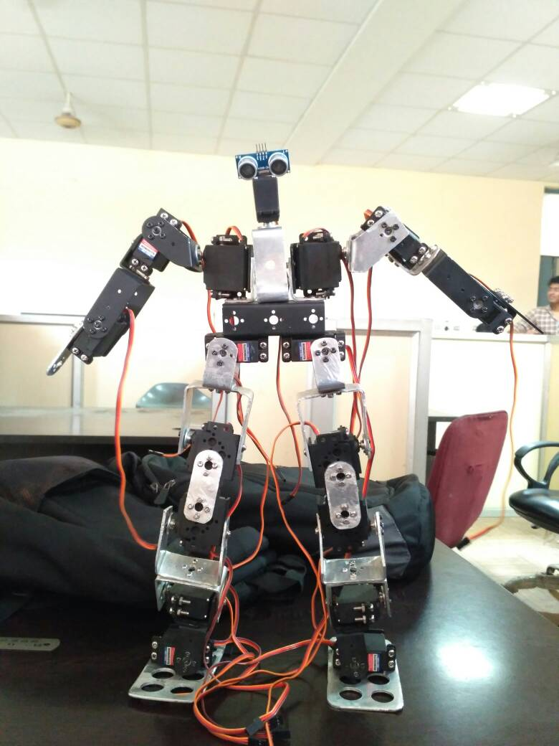
SKYLINE INSTITUTE OF ENGINEERING AND TECHNOLOGY GREATER NOIDA
PROJECT PRESENTATION ON
HUMANOID ROBOT (ALUMINA)
PRESENTED BY:- MOHD MONISH
ADITYA SINGH
GOVIND SINGH
ATIQUR RAHAMAN
VINEET JAISWAL
MAYANK RAI
(MECHNICAL 4TH YEAR )
GUIDANCE BY:- ER. ANKIT MANI TRIPATHI
(FACULTY MECHANICAL DEPARTMENT)

Slide 2
CONTENTS
HISTORY
OBJECTIVES
INTRODUCTION
LAWS OF ROBOT
BASIC MATERIAL REQUIREMENT
SERVOMOTOR & ITS WORKING
ARDUINO CIRCUIT
ULTRASONIC SENSOR
CALCULATIONS OF ALUMINA
CONCLUSION
REFERENCES

Slide 3
SUMMARY OF ALUMIA
A Humanoid Robot is a Robot with its body shaped design & assembled to resemble the human body.
Its design maybe intended for functional purposes, such as interacting with human tools & environments, for experimental purposes, such as the study of bi-pedal locomotion or for other purposes.
When it comes to the design of the humanoid robot in general humanoid robot has a torso, a head, 2 arms & 2 legs, though some forms of humanoid robot may model only part of the body, for example, for the waist up.
In this project we have design & assembled a humanoid robot with aluminum sheet as the main structural material or the thickness of the sheet used is 2.5mm. We have programmed this robot for the purpose of personal assistance.
As this robot performs it functions on the basis of commands given by us.
Our project is a very significant step in the field of robotics world as we will explore the amazing functions of a humanoid robot.

Slide 4
HISTORY
Lie Zi described about automation 250BC on which Robots works.
Greek mathematician Hero of Alexandria described a machine to automatically pour wine for party guests in 50AD.
Leonardo da Vinci designs a humanoid automaton that looks like an armoured knight, known as Leonardo's robot in 1495.
Isaac Asimov formulates the Three Laws of Robotics, used in his robot science fiction stories in 1941 – 42.
Honda creates its 11th bipedal humanoid robot, able to run ASIMO in 2000 and further amendments were done till now.
iCub, a biped humanoid open source robot for cognition research 2006 (it is actually a spoiled baby having height 100cm & Weight 23kg).

Slide 5
OBJECTIVE
Our Aim is to built a Robot, Which can shake hand walk and provide some moments to it.
It can do some simple task like to turn when obstacles came in play while moving the robot.
FUTURE ASPECTS & PERFORMANCE OF THIS ROBOT
In Future we can modify it circuit & do programming for increasing the flexibility of this Robot.
We are going to modify its degree of freedom.

Slide 6
A robot is a re-programmable multifunction manipulator designed to move materials, tools or specialized devices through variable programmed motions.
WHAT IS ROBOT?
WHAT IS HUMANOID ROBOT?
A humanoid robot is a robot with its body shape built to resemble the human body, having torso, two legs, a head & two arms.

Slide 7
WHAT ARE THE LAWS 0F HUMANOID ROBOT?
Zeroth Law:- “A Robot must not injure humanity although in action, allow humanity come to harm”.
First Law:- “A Robot must not harm a human body although in action, allow one to come to harm”.
Second Law:- “A Robot must always obey human being, unless it is in conflict with a higher order law”.
Third Law:- “A Robot must protect itself from harm unless that it is conflict with a higher order law”.

Slide 8
BASIC MATERIAL REQUIREMENT
Metal Gear Standard Servo Economy
Arduino Uno R3 based Bluetooth + USB 18 Servo Controller
Ultrasonic sensor
Lithium Polymer ( Li-Po) Rechargeable Battery 7.4V 1500mAH 20C
Clamps
Miniature Ball Radial Bearing
Metal Horn for Servo 25T
Screw and screw cap set

Slide 9
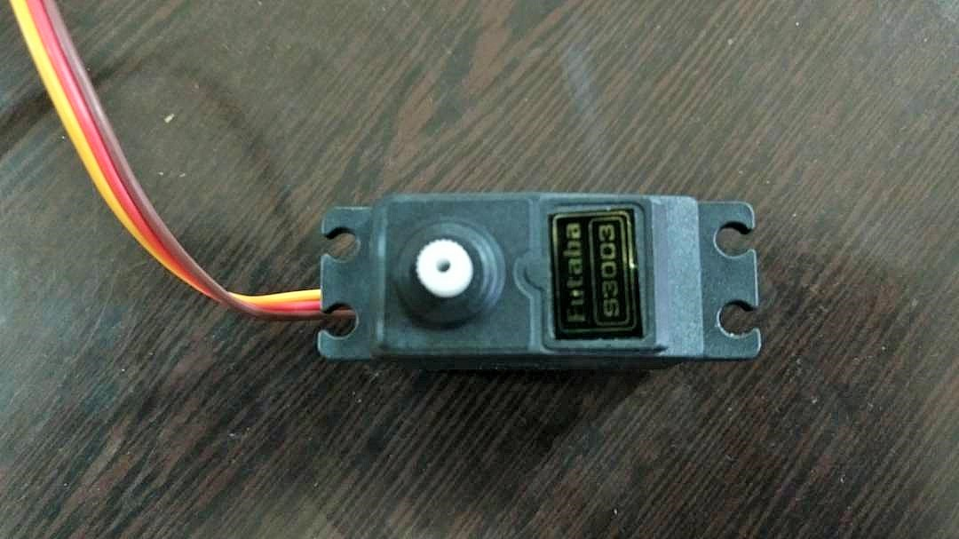
What Is Servo Motor?
A servo motor is an electrical device which can push or rotate an object with great precision. If you want to rotate an object at some specific angles or distance, then you use servo motor. It is just made up of simple motor which run through servo mechanism.
It consists of three parts:
Controlled device
Output sensor
Feedback system

Slide 10
How Servo Motor Works In Humanoid Robots?
A servo consists of a Motor (DC or AC), a potentiometer, gear assembly and a controlling circuit.
First of all we use gear assembly to reduce RPM and to increase torque of motor.
Say at initial position of servo motor shaft, the position of the potentiometer knob is such that there is no electrical signal generated at the output port of the potentiometer.
Now an electrical signal is given to another input terminal of the error detector amplifier.
Now difference between these two signals, one comes from potentiometer and another comes from other source, will be processed in feedback mechanism and output will be provided in term of error signal.
This error signal acts as the input for motor and motor starts rotating.

Slide 11
What Is Arduino Circuit?
In our project, it is the circuit which is used to control the servo & sensor actions by the help of electrical power supply.
This device can be operated wirelessly on Bluetooth or through USB connection.
Arduino Uno R3 based Bluetooth + USB 18 Servo Controller is ideal for making Autonomous and PC based systems which run over Hobby Servo motors.
The software helps to develop the complex sequences in real time on the hardware like robotic arms, walkers, bipeds and any other servo controlled system.
It also generates Arduino based code for the developed sequence which can be deployed on the controller on board thereby making the robot autonomous.

Slide 12
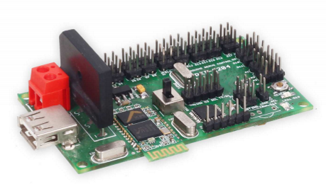
Arduino Circuit & Its Specifications?
Bluetooth interface for wireless control of robots
Controls 18 hobby servos from PC and Microcontroller
USB interface
Comes Pre-loaded Arduino Uno boot loader
Independent range setting for each servo
0.5-microsecond resolution
50 Hz update rate
Small size of 80 X 47 mm
Home and neutral position setting

Slide 13
What Is Ultrasonic Sensor?
Ultrasonic sensors “are based on the measurement of the properties of acoustic waves with frequencies above the human audible range,” often at roughly 40 kHz . They typically operate by generating a high-frequency pulse of sound, and then receiving and evaluating the properties of the echo pulse.
Three different properties of the received echo pulse may be evaluated, for different sensing purposes. They are:
Time of flight (for sensing distance)
Doppler shift (for sensing velocity)
Amplitude attenuation (for sensing distance, directionality, or attenuation coefficient)

Slide 14
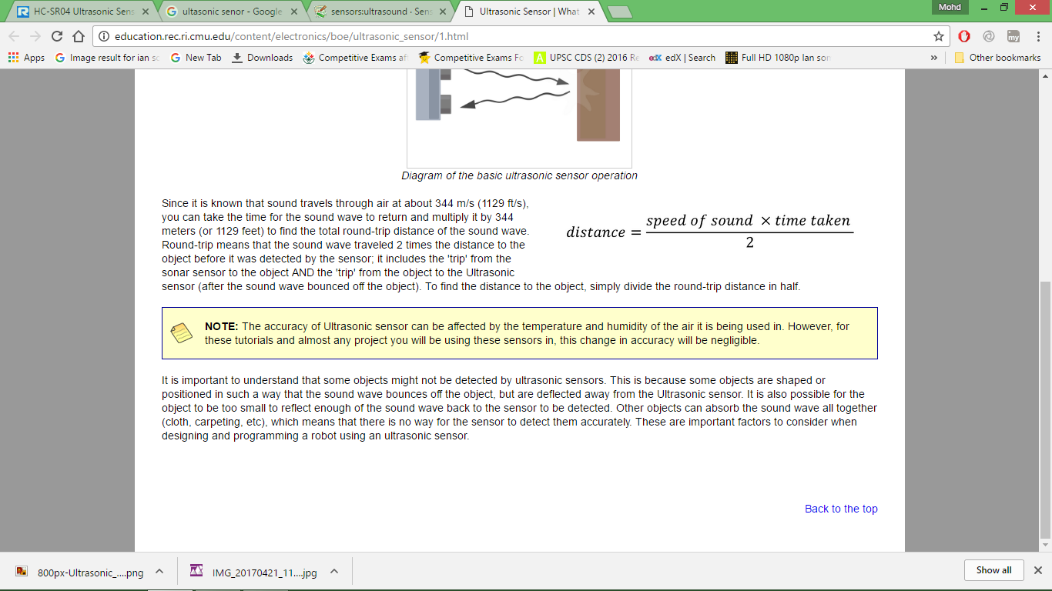
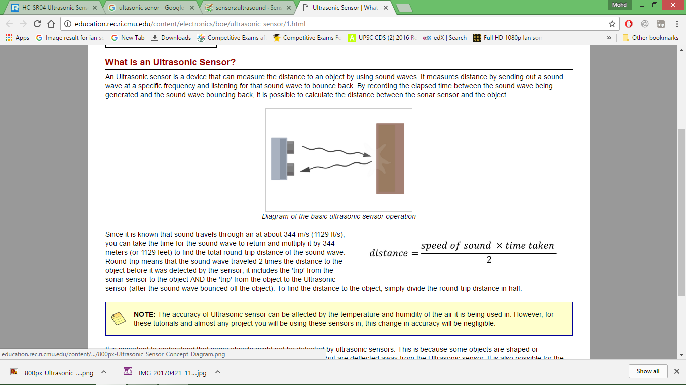
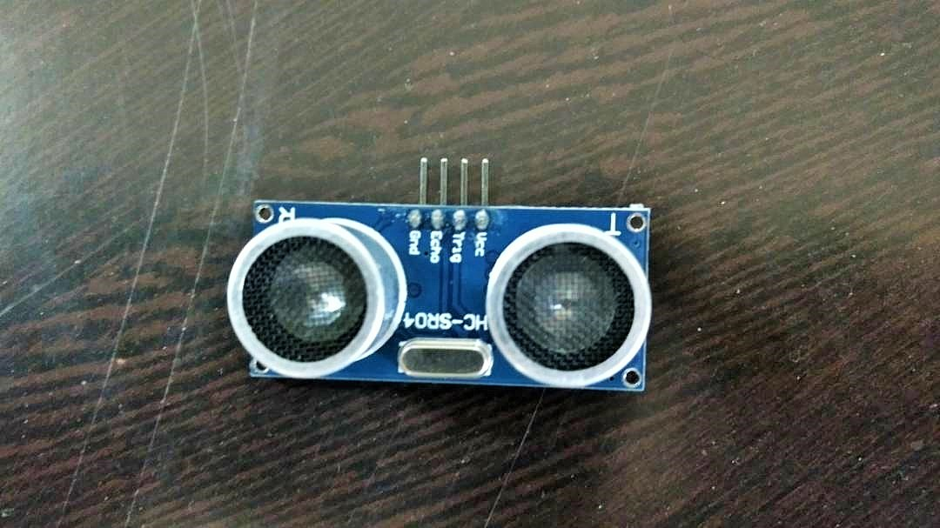
Working Of Ultrasonic Sensor
This performance of the ultrasonic sensor distance measuring module is stable, measure the distance accurately. The module is with High precision, blind spots (3cm) super close. This module provides a full set of ranging process.

Slide 15
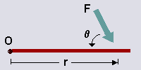
Calculations & Designing Criteria For Alumina
Torque:-
Torque is a measure of how much a force acting on an object causes that object to rotate. The object rotates about an axis, which we will call the pivot point, and will label 'O'. We will call the force 'F'. The distance from the pivot point to the point where the force acts is called the moment arm, and is denoted by 'r'. Note that this distance, 'r', is also a vector, and points from the axis of rotation to the point where the force acts.
Torque is defined as,
T = r *f
Where, T = Torque
r = radial distance
f = force

Slide 16
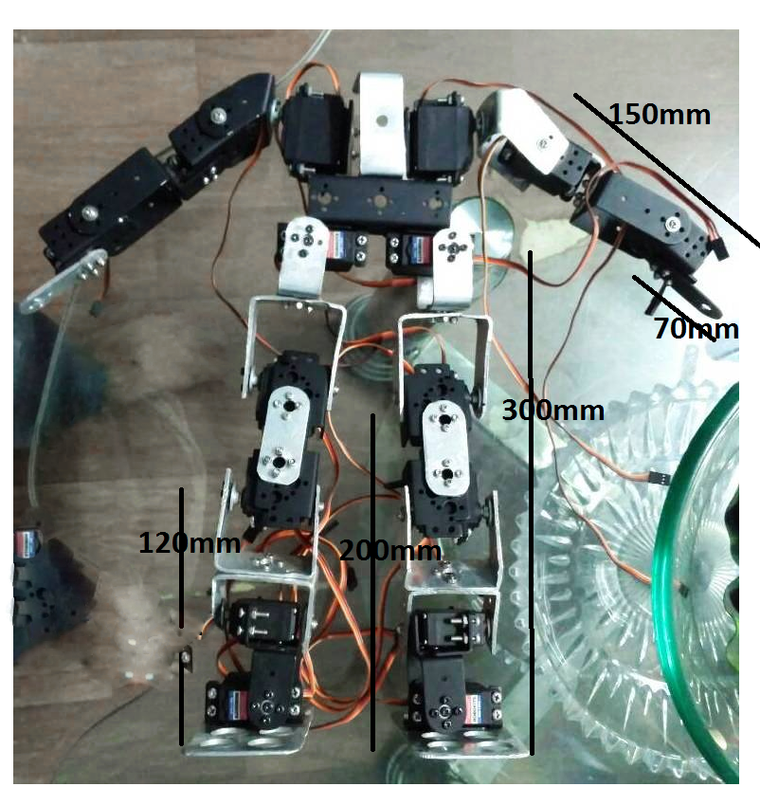
Selection Criteria’s?
Defining the selection of servo torque in the different parts of ALUMIA:
In this figure the radial distances of the robot are provided to find the torque, by which we decide the torque of motor according to our need.
The overall weight of the ALUMIA is 3 kg, then according to parts it is divided.
The value of g is 10 m/s².
We consider factor of safety (FOS) as 1.5

Slide 17
Deciding parameters for the motor of THIGH on torque characteristics
The total force applied on the thighs is 10N (i.e. due to weight of robot (mg), where m = 1kg).
The perpendicular distance from this to the end point is 300mm.
As we know that, the load is UDL but it is not perfectly UDL (Uniformly distributed load) approximately, so we do all the calculations on UDL & take some FOS for the safety of servo motor.
If the load is 10N, & distance is 300mm, the maximum angle fluctuation is 45 degree.
Then, torque = (10*300sin (45))/2
= 106 N-cm.
Then on applying FOS torque = 1.5*106
= 159 N-cm = 15.9 kg-cm
NOTE: - So we selected 16 kg-cm torque servo motor.

Slide 18
Deciding parameters for the motor of KNEE on torque characteristics
The total force applied on the thighs is 6 N (i.e. due to weight of robot (mg), where m = 0.6 kg).
The perpendicular distance from this to the end point is 200 mm.
If the load is 6 N, & distance is 200mm, the maximum angle fluctuation is 45 degree.
Then, torque = (6*200sin (45))/2
= 42.42 N-cm.
Then on applying FOS torque = 1.5*42.4
= 63.6 N-cm = 6.36 kg-cm
NOTE: - So we selected 8 kg-cm torque servo motor because the servo doesn’t came in
7 kg-cm torque.

Slide 19
Deciding parameters for the motor of KNEE joint on torque characteristics
The total force applied on the thighs is 4 N (i.e. due to weight of robot (mg), where m = 0.4 kg).
The perpendicular distance from this to the end point is 120 mm.
If the load is 4 N, & distance is 120mm, the maximum angle fluctuation is 45 degree.
Then, torque = (4*120sin (45))/2
= 17 N-cm.
Then on applying FOS torque = 1.5*17
= 26 N-cm = 2.6 kg-cm
NOTE: - So we selected 4 kg-cm torque servo motor because the servo doesn’t came in
3 kg-cm torque.

Slide 20
Deciding parameters for the motor of SHOULDER on torque characteristics
The total force applied on the thighs is 5 N (i.e. due to weight of robot (mg), where m = 0.5 kg).
The perpendicular distance from this to the end point is 150 mm.
If the load is 5 N, & distance is 150mm, the maximum angle fluctuation is 90 degree.
We design the arm for point load, because in arm the weight of servo is low, so we take that the load is applied on the end of the arm.
Then, torque = 5*150
= 75 N-cm.
Then on applying FOS torque = 1.5*75
= 112.5 N-cm = 11.25 kg-cm
NOTE: - So we selected 14 kg-cm torque servo motor to improve the performance of the hands of ALUMINA.

Slide 21
CONCLUSION
In this project we have designed a humanoid robot by servo motor as its main motion provider & lithium polymer battery as its main source of power. Aluminum sheets have been used as a building block or body of the robot.
The designed robot is purposed for the assistance & to follow orders as per the instructions given to it. The Instruction of walking, turning has been programmed by the help of arduino programming language which is to be saved in0 the arduino circuits to perform the action of the robots as ordered.
In this project our humanoid robot (ALUMINA) has been designed to follow commands, when we command it to walk, it starts walking & only stops when it command to do so.
We have installed some sensors in it to sense various obstructions & threats.
They can perform all the heavy task without taking much time & without doing any mistakes & causing any delay.

Slide 22
REFERENCES
Albert Albers, Sven Brudniok, Jens Ottnad, Christian Sauter, Korkiat Sedchaicharn University of Karlsruhe (TH), ‘Design of Modules and Components for Humanoid Robots’, Institute of Product Development Germany.
Collette, C., Micaelli, A., Andriot, C. & Lemerle, P. (2007) ‘Dynamic balance control of humanoids for multiple grasps and non-coplanar frictional contacts’, ‘Humanoid Robots’, 2007 7th IEEE-RAS International Conference.
G.J. Monkman, S. Hesse, R. Steinmann & H. Schunk (2007), ‘Robot Grippers’ – Wiley, Berlin.
http://robokits.co.in/, homepage of Robokits India, Gandhinagar, India.
https://www.arduino.cc/, hompage of Arduino.

Slide 23
THANKS

